Slide 1
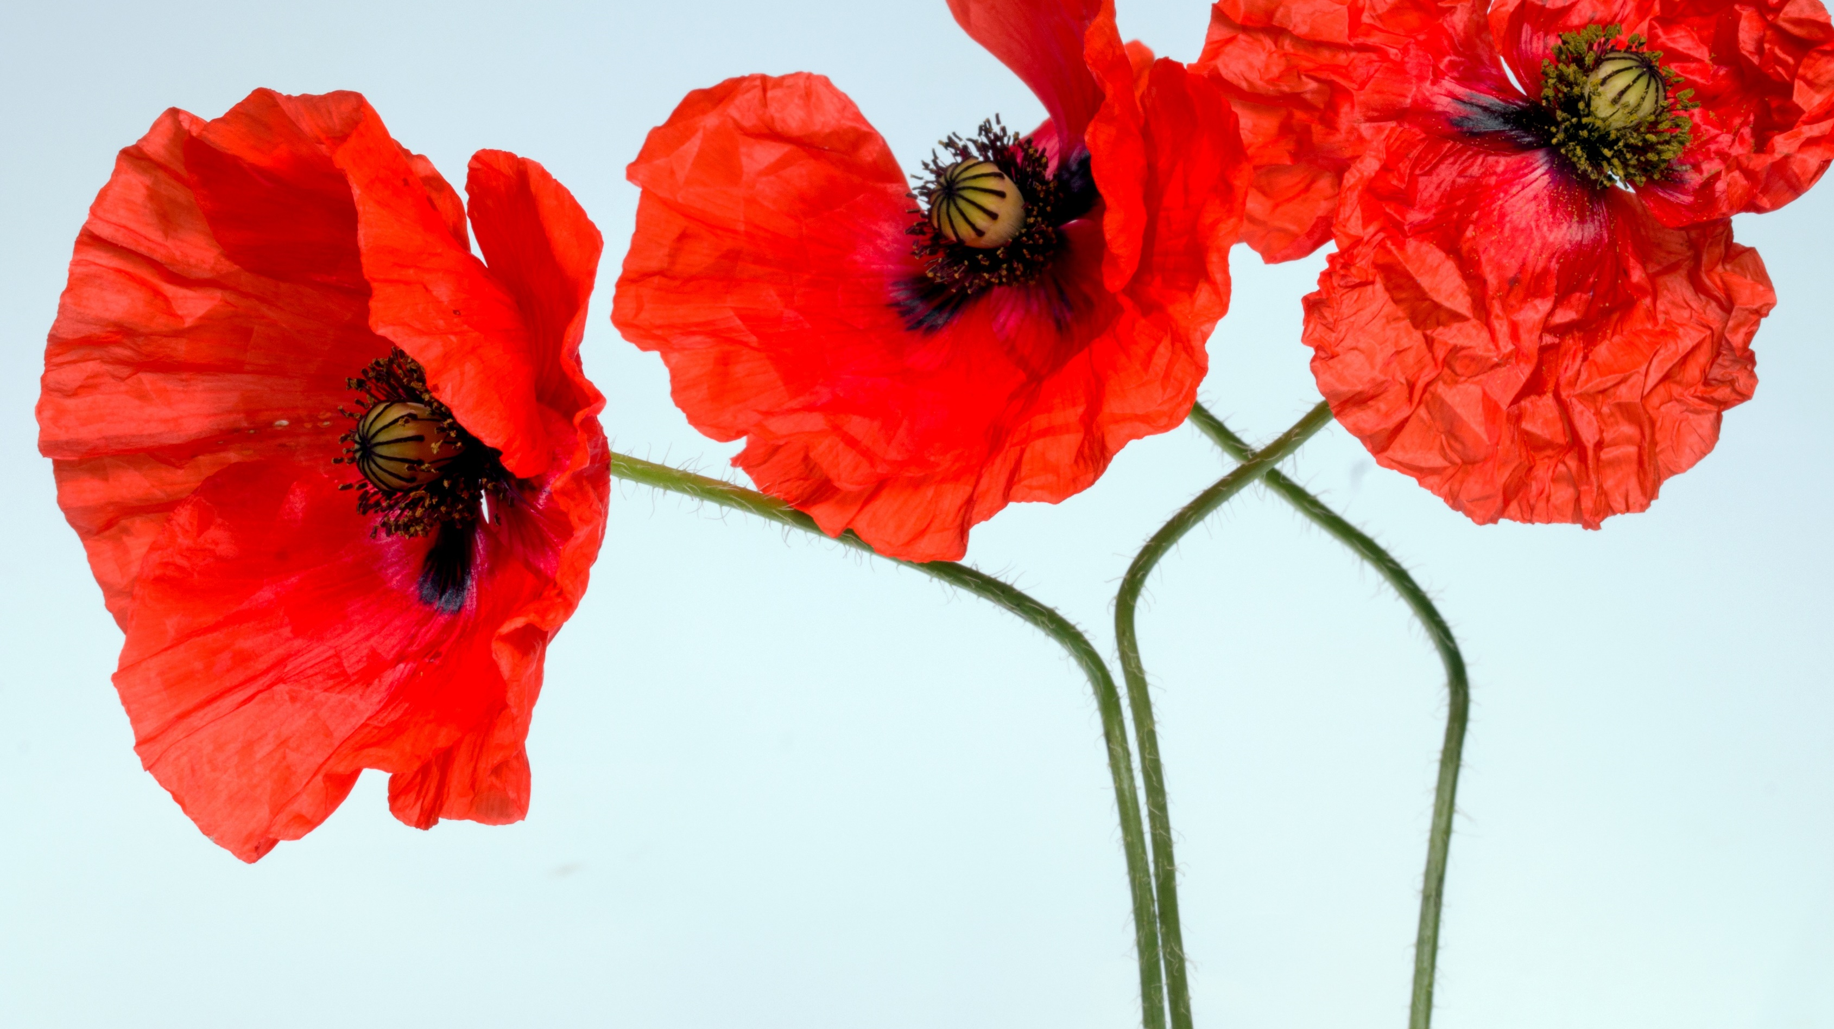
Remembrance Day Project
Kevin Li

Slide 2
Why I chose this song
The name of the song is called The Last Post by Josef Pitura-Riley. I chose this song because it is quiet, and it makes people more thoughtful.

Slide 3
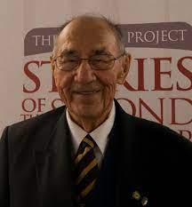
Photoof a veteranor current militarypersonyou know with introduction including their name and any relevant info about their service.
Elmer James Sinclair
When he was a Royal Canadian Corps of Signals his job was to communicate between squadrons or between stations.
He was sent to France with the British Division for a month before going back to Canadian Headquarters. His job was to make sure the stations stayed on frequency.

Slide 4
Self-reflectionslide centered around the following opinion questionswhich should be
When I hear the word Remembrance for me it means soldiers die in the wars to protect us.
Remembrance day helps me nothing.
We have Remembrance day to think about the soldier death to help this country.

Slide 5
Conclusion slide -How will show your recognition on Remembrance Day 2021?
I will show my recognition by being respectful, kind, and quiet to the soldiers when I encounter them.

